Slide 1
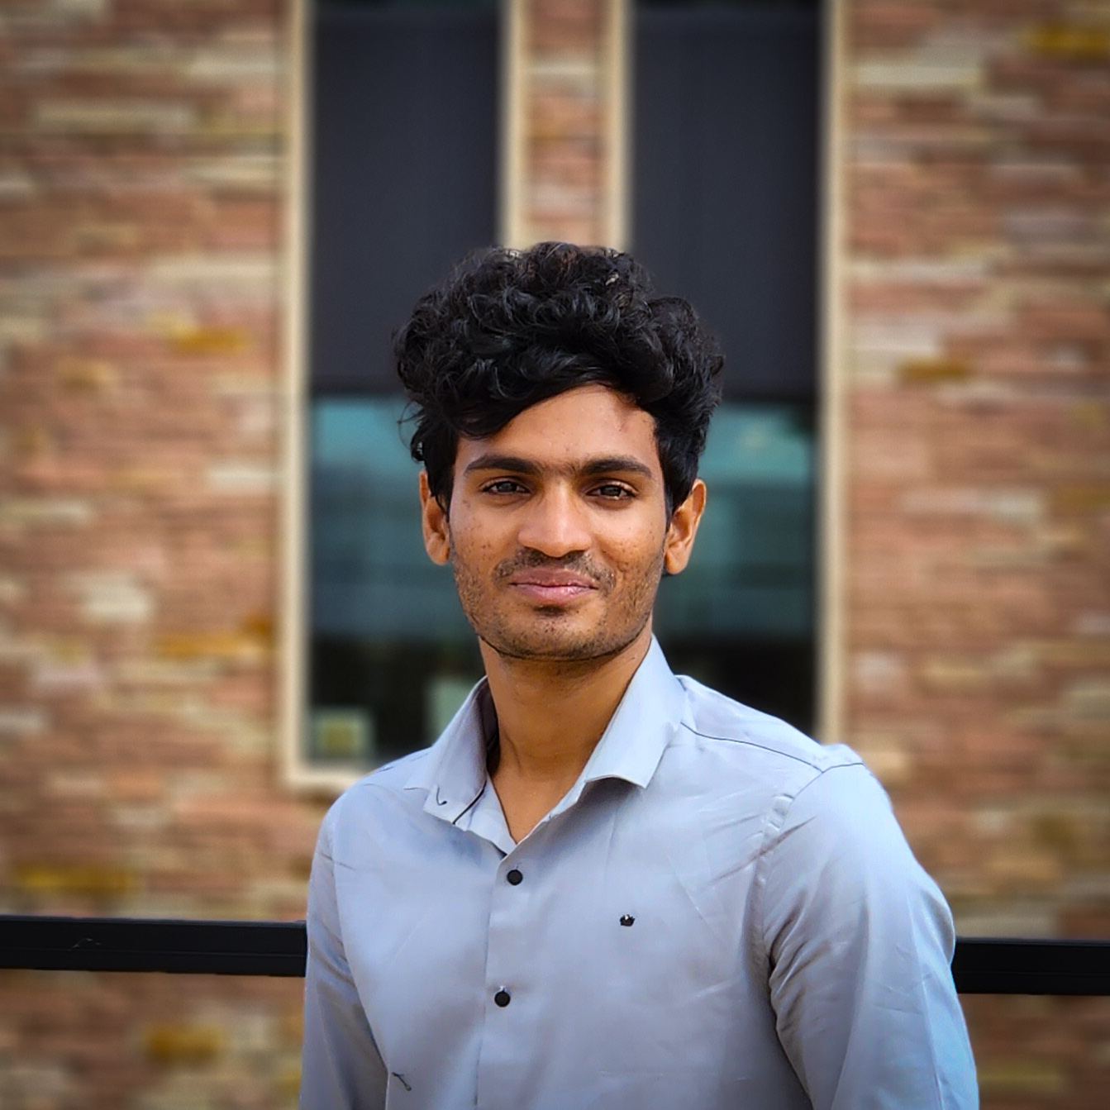



Dock Watch
Course Code: CSCI 5502
Course Name: Data Mining
Instructor: Dr. Osita Onyejekwe
Agenda
Objective breakdown
Data Collection and Data Flow Architecture
Exploratory Data Analysis
Modeling & Results
Conclusion & Future Works
Niranjan Cholendiran
Santhosh Pattamudu Manoharan
Notes:
Hi Everyone, I’m Niranjan. Myself and my teammate Santhosh are going to present our project Dock Watch
We are Data Science graduate students at CU Boulder and this project is a part of CSCI 5502 Data Mining course under Dr. Osita.
Agenda:
Objective breakdown
Data Collection and Data Flow Architecture
Exploratory Data Analysis
Modeling & Results
Conclusion & Future Works

Slide 2




Objective: Estimate the bicycles waiting period at the Boulder BCycle stations.
Public bicycle sharing company
47
Locations across the U.S.

Slide 3
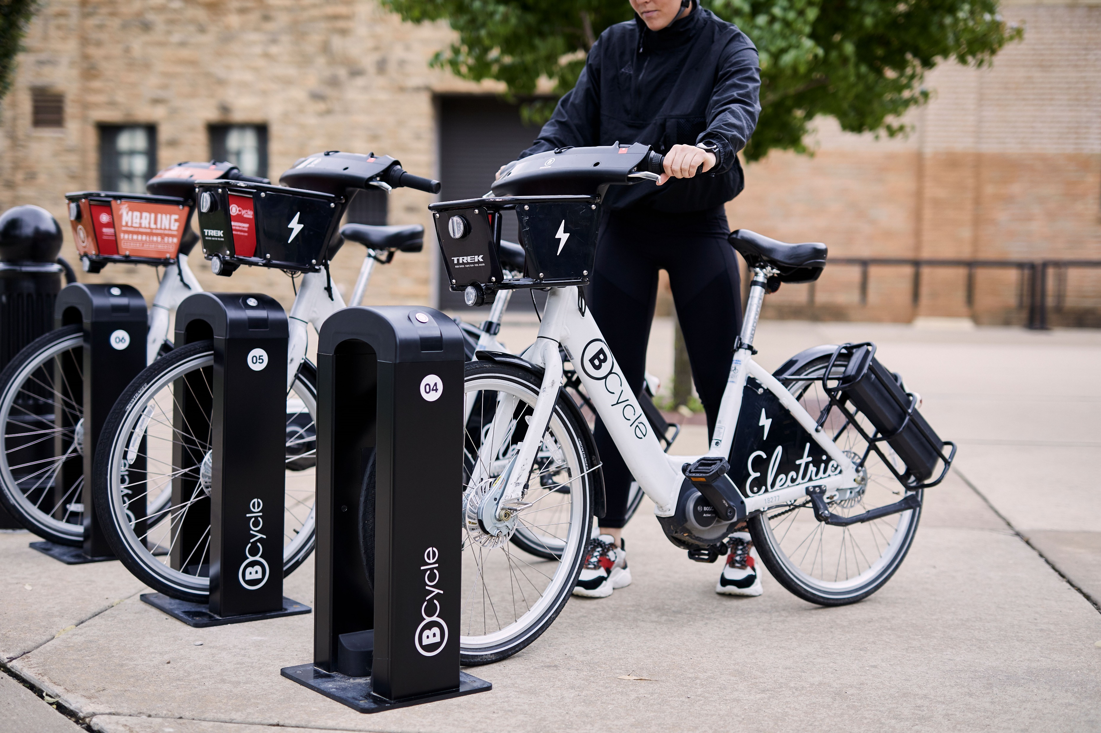

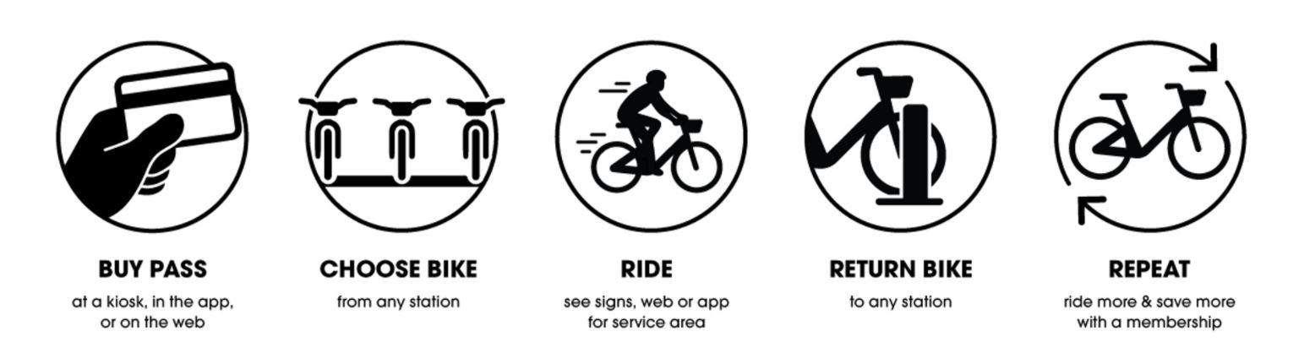

Objective: Estimate the bicycles waiting period at the Boulder BCycle stations.
Public bicycle sharing company
Membership Program
47
Locations across the U.S.
Mobile Application
Notes:
Public bicycle sharing company. Advantage is they provide electric bicycles- so it’s easier to pedal than regular bicycles.
Available in 47 cities across the U.S. There are multiple charging stations available in each city.
They provide membership program- where you can pay upfront and use the cycles for allotted time period.
There’s mobile application where you one can track the station locations, number of cycles available, etc

Slide 4

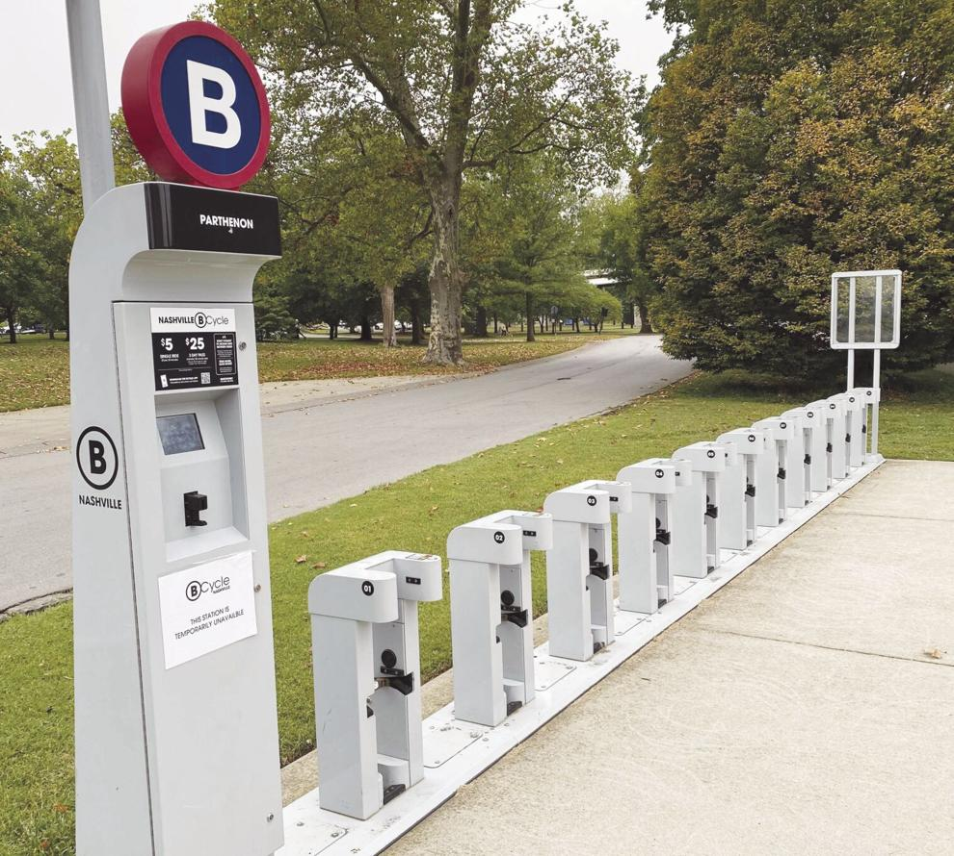
Objective: Estimate the bicycles waiting period at the Boulder BCycle stations.
Wait Time
< 20 mins | Very Low
20 – 40 mins | Low
40 – 60 mins | Moderate
> 60 mins | High
Public bicycle sharing company
Membership Program
47
Locations across the U.S.
Mobile Application
Notes:
Boulder BCycle is one of the most popular across all 47 cities.
Main reason is because they provide free membership to CU Boulder students, hence it is often used by CU students to commute between campus and their house.
I personally use it almost everyday, it saves my time waiting for public transports, if not I have to get 2 busess to reach the campus.

Slide 5
Objective: Estimate the bicycles waiting period at the Boulder BCycle stations.
Wait Time | Wait Time Category
< 20 mins | Very Low
20 – 40 mins | Low
40 – 60 mins | Moderate
> 60 mins | High
Notes:
The mobile app have does not have any information regarding how long one has to wait if the station is empty or have less number of bikes, so we want to bring in that feature.
Now, why is it important? Since it is very popular among students the popular stations often times runs out of bike so students have to wait without knowing if they’ll get one soon.
I personally have waited more than 30 mins and ended up not getting one.
That’s where this project kicks in- We aim is to analyze the usage trend of cycles at different stations and at different times, find a pattern, figure out the factors that influence the usage of cycles and use to build a ML model that can estimate the wait time at any point of the time.
This is a classification problem that’s gonna predict the wait time category starting from “very low” wait time if one can expect a new cycle in within 20mins to “very high” depicting more than an hour.
On an average, the wait time for public busses in Boulder is 30mins. So, if we can predict the cycle availability within 20mins accurately, then that’s gonna save a lot of time- you can use this to plan your day accordingly!!!
Hope the objective of our project is clear. Let’s now move on to the technical part of the project.

Slide 6
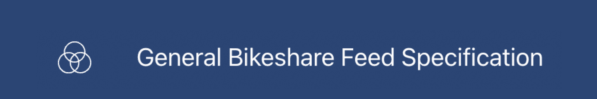






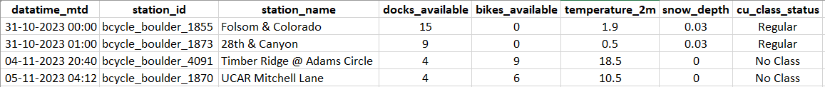
Data Flow Architecture
Freq: 3 mins
BCycle Station Status Data
EDA/ Visualization
Data Collection
Data Storage
Freq: 1 hour
Amazon EC2
Modeling
Temperature Data
Freq: 1 day
CU Class Status Data
Preprocessing Pipelines
Notes:
This is our complete data flow architecture: Strating from data collection to modelling. Let me break it down quickly.

Slide 7
Data Flow Architecture
Data Collection
EDA/ Visualization
BCycle Station Status Data
CU Class Status Data
Data Storage
Temperature Data
Freq: 3 mins
Freq: 1 hour
Freq: 1 day
Since OCT 31st
Amazon EC2
Modeling
BCycle Station Status
Temperature
CU Class Status
Handle Missing Values
Normalization
Label Encoding
Combined 2 tables (Temp)
Preprocessing Pipelines
Notes:
We used 3 APIs to get data:
GBFS- to get the live BCycle station status- Problem with this API is it only provides the current station status but not historical data (for example, number of bikes available in a particular station at the time when API is called) so we had to call the api frequent and we were pulling it every 3 mins.
OpenMeteo API which gives the temperature data- Because we noticed temperature had a major influence in the cycle usage pattern.
CU Boulder Class Search website- To obtain the class calendar to check if classes are scheduled on a particular day, again because we noticed that it influenced cycle usage pattern.
Finally we used, Amazon EC2 instances to run python query to pull the data continuously without any interruption.
Here’s a snapshot of the data- Our dataset has 43 columns and I’ve displayed a part of it. We have been collecting data since Oct 31st

Slide 8
Data Flow Architecture
Data Collection
Data Storage
EDA/ Visualization
BCycle Station Status Data
CU Class Status Data
Freq: 3 mins
Freq: 1 hour
Freq: 1 day
Temperature Data
Since OCT 31st
Amazon EC2
Handle Missing Values
Normalization
Label Encoding
Join Tables
Modeling
BCycle Station Status
Temperature
CU Class Status
Preprocessing Pipelines
Notes:
The collected data is stored in the PostgreSQL, from which the data is pulled for preprocessing all standard methods like:
Handling missing values
Normalization
Label encoding
Join tables
and more
Finally the pre-processed data is again stored in the PostgreSQL as a different table.

Slide 9
Data Flow Architecture
Data Collection
Data Storage
EDA/ Visualization
Amazon EC2
Modeling
Preprocessing Pipelines
Handle Missing Values
Normalization
Label Encoding
Join Tables
Notes:
The pre-processed data is finally pulled into Tableau for EDA and Visualization and the same data is used for Modeling

Slide 10
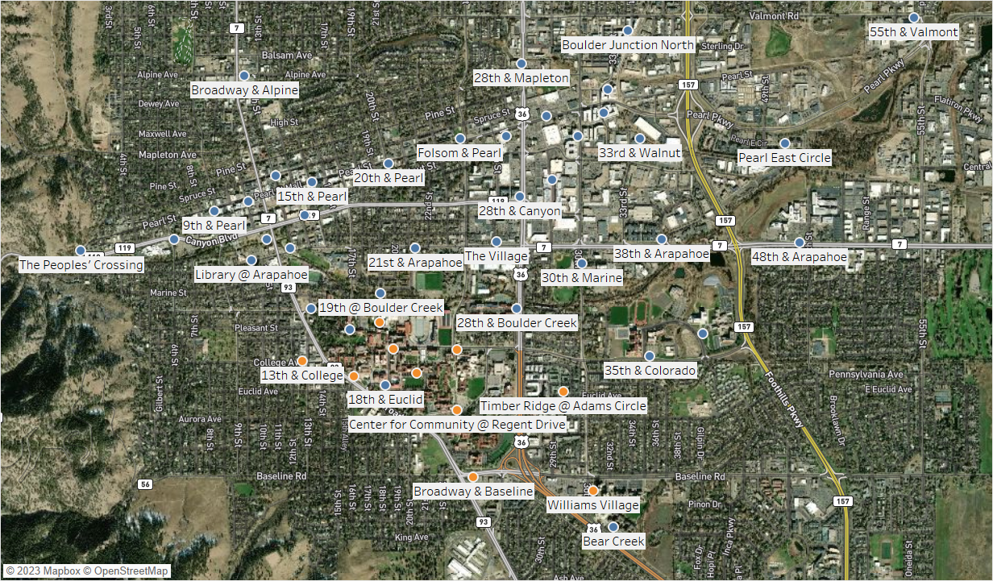
EDA: Popular Stations
Notes:
I will be covering a few EDA results which we have performed this analysis.
Starting with the popular stations:
There were a total of 54 stations located throughout the city.

Slide 11
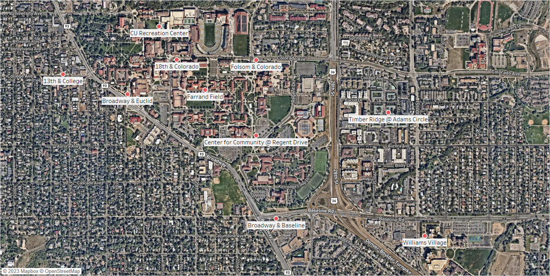
EDA: Popular Stations
Notes:
Out of which these are the top 10 stations based on usage frequency.
One who's familiar with the map can realize

Slide 12
EDA: Popular Stations
Main Campus
East Campus
Notes:
that most of these stations are located close to hotspots of CU Campus. Like the library, Rec Center, Engineering building, C4C, Will Vill campus etc
The further analysis are done only for these top 10 stations

Slide 13
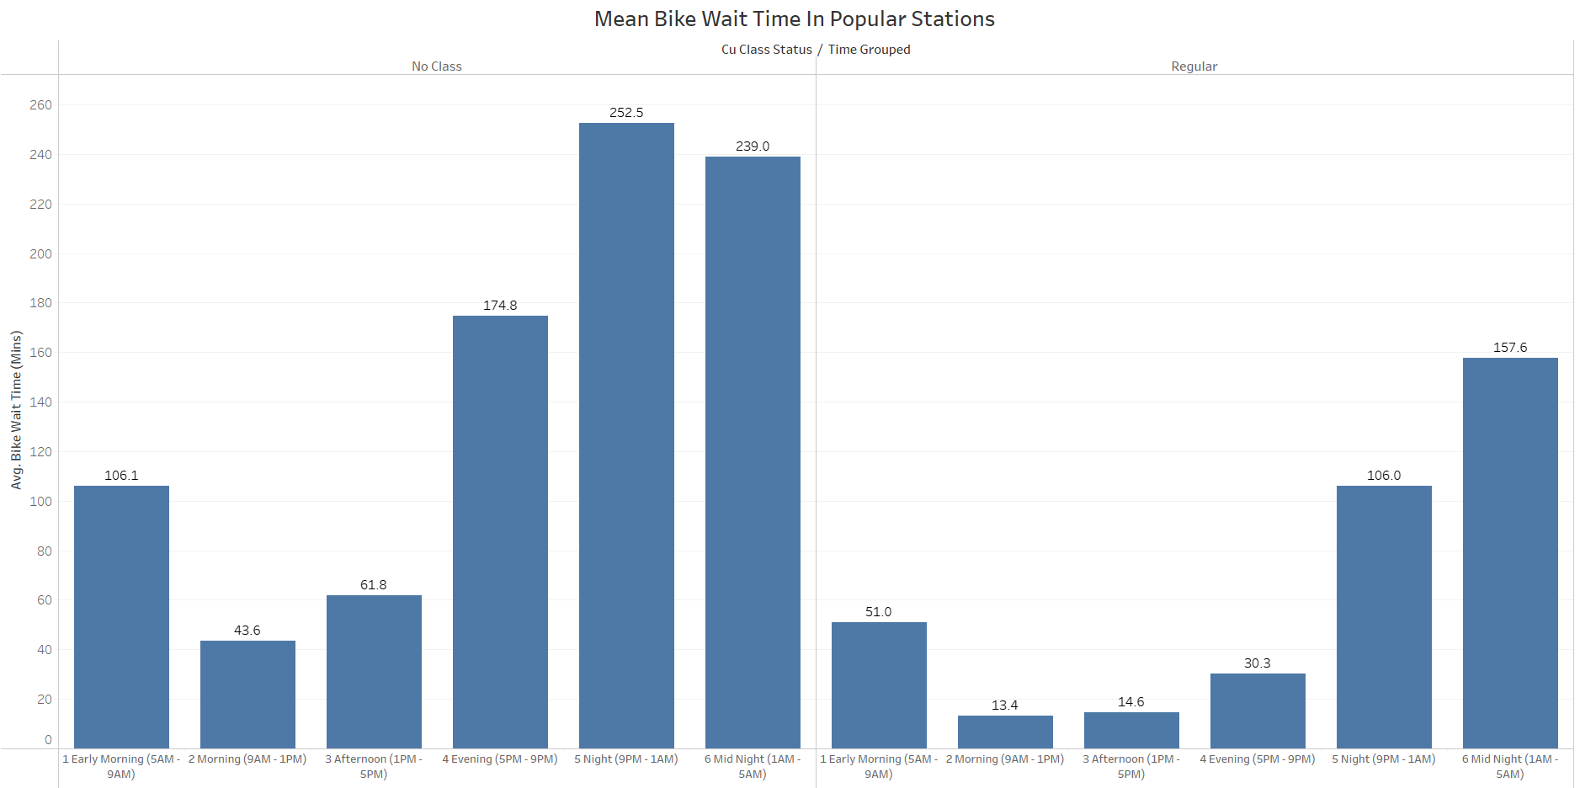
EDA: Morning – Evening on Regular class days are the busiest
Support Vector Machine
XGBoost Classifier
Random Forest Classifier
Notes:
These are the average wait time among the popular stations split by time of the day and CU Class status.
Notice that the stations are very busy between Morning – Evening especially on days when there were regular classes happening.
We used this information to split our result and see how our model performs in the these busy times.
Ideally, we aimed to have high accuracy during busy times as that is when stations go empty most of the times.

Slide 14



Modeling & Results
Support Vector Machine
58%
XGBoost Classifier
Hyperparameter Tuning
62%
Morning – Evening
Random Forest Classifier
66%
75%
Cross Validation
Regular Classes
Notes:
For modeling we experimented with 3 models that specifically work better for multiclass classification, which can handle class imbalances and extract complex relationship from the temporal data: SVM, XGBoost and Random Forest.
We have done the train test split by time period to have more credible prediction results
Which is we have used the November months data for training
tested it with the December months data, to make our prediction results more accurate.
After hyperparameter tuning and cross validation, we achieved an highest accuracy of 66% using RF Classifier.
So this is for the overall dataset where in ourn usecase this feature will come to play during the peak hours as Niranjan mentioned.
So we’ll analyze the result further

Slide 15
Modeling & Results
Support Vector Machine
58%
XGBoost Classifier
Hyperparameter Tuning
62%
Morning – Evening
Random Forest Classifier
66%
75%
Cross Validation
Regular Classes
Notes:
So in our peak times we got an accuracy of 75 %
The model was able to do better during the busiest time because the variance of wait times during these times were low and the model was able to capture this trend.
Additionally, we noticed that the variance of wait time were very different among stations. So that will definitely influence the model’s prediction

Slide 16
Modeling & Results
Morning – Evening
66%
75%
Regular Classes
“Very Low” wait time | Precision | 66%
 | Recall | 79%
 | F1 | 72%
Notes:
Hence, when we split the 75% accuracy among stations, we noticed that stations with less wait variance recorded high accuracy where we achieved an accuracy above 80% in few stations with the highest in C4C with 89%.
Though, accuracy is a good overall estimator of model’s prediction,
More than accuracy. In this problem statement it is important to have high recall and precision for the “Very Low” Category. As that is the most important category that tells if a person should wait or not- so we want the model to predict that category accurately.

Slide 17
Modeling & Results
Morning – Evening
66%
75%
Regular Classes
“Very Low” wait time | Precision | 66%
 | Recall | 79%
 | F1 | 72%
Notes:
So, we recorded recall, precision and the F1 score as the following. This is better than other target classes as we needed.

Slide 18
Conclusion
This model can be used for predicting wait times at the top 10 popular stations, and it accurately predicts the “Very Low” category compared to other categories, particularly during the busiest time of the day.
Notes:
Where it is highly needed

Slide 19




Future Work
www.linkedin.com/in/niranjan-cholendiran
niranjan.cholendiran@colorado.edu
Extend the model to other stations
Increase the model accuracy to predict other wait time categories and during the inactive time of the day.
https://www.linkedin.com/in/santhosh-pattamudu-manoharan
santhosh.pattamudumanoharan@colorado.edu
Notes:
Extend the model to predict other stations,
Predict accurately for other target categories which are low h , For which, the main need is more data. We barely used a month of data for training and that wasn’t enough to capture all the trends.
So we are aiming to collect more data and get historical data from BCycle to proceed further.

Slide 20
References
Rastpour, A., & McGregor, C. (2022). Predicting Patient Wait Times by Using Highly Deidentified Data in Mental Health Care: Enhanced Machine Learning Approach. JMIR Mental Health, 9(8). https://doi.org/10.2196/38428
Erjie Ang, Sara Kwasnick, Mohsen Bayati, Erica L. Plambeck, Michael Aratow (2015) Accurate Emergency Department Wait Time Prediction. Manufacturing & Service Operations Management 18(1):141-156.https://doi.org/10.1287/msom.2015.0560
Sun, Y., Teow, K. L., Heng, B. H., Ooi, C. K., & Tay, S. Y. (2012). Real-Time Prediction of Waiting Time in the Emergency Department, Using Quantile Regression. Annals of Emergency Medicine, 60(3), 299-308. https://doi.org/10.1016/j.annemergmed.2012.03.011
Shaik, A.B., Srinivasan, S. (2019). A Brief Survey on Random Forest Ensembles in Classification Model. In: Bhattacharyya, S., Hassanien, A., Gupta, D., Khanna, A., Pan, I. (eds) International Conference on Innovative Computing and Communications. Lecture Notes in Networks and Systems, vol 56. Springer, Singapore. https://doi.org/10.1007/978-981-13-2354-6_27
Grandini, M., Bagli, E., & Visani, G. (2020). Metrics for Multi-Class Classification: An Overview. ArXiv. /abs/2008.05756
Har-Peled, S., Roth, D., Zimak, D. (2002). Constraint Classification: A New Approach to Multiclass Classification. In: Cesa-Bianchi, N., Numao, M., Reischuk, R. (eds) Algorithmic Learning Theory. ALT 2002. Lecture Notes in Computer Science(), vol 2533. Springer, Berlin, Heidelberg. https://doi.org/10.1007/3-540-36169-3_29
www.linkedin.com/in/niranjan-cholendiran
niranjan.cholendiran@colorado.edu
https://www.linkedin.com/in/santhosh-pattamudu-manoharan
santhosh.pattamudumanoharan@colorado.edu
Notes:
Extend the model to predict other stations,
Predict accurately for other target categories, and idle time of the day.
For which, the main need is more data. We barely used a month of data for training and that wasn’t enough to capture all the trends.
So we are aiming to collect more data and get historical data from BCycle to proceed further.

Slide 21
Reach us out on our LinkedIn/email for collaboration on any mentioned future work.
Github repository
Tableau dashboard link
www.linkedin.com/in/niranjan-cholendiran
niranjan.cholendiran@colorado.edu
https://www.linkedin.com/in/santhosh-pattamudu-manoharan
santhosh.pattamudumanoharan@colorado.edu
Notes:
Reach out to us on LinkedIn or email, if you have any questions or would like to collaborate on the future works.

Slide 22
Sko Buffs!

